Slide 1
V6 Performance, Capacity and Scalability
Sizing and Capacity Planning for the ENOVIA V6 Server Environment

Slide 2
Owner and Revision History
Owners: Bernard Vermersch and Olivier Dechoux (DS), Michael Finocchiaro (IBM)
Contributors: Jean-Louis Flatrès, Augustin Fernandez, Jean-Paul Vassoux, Jean-Philippe Vanpe, Etienne Landon
Revision History:
Version | Modifier | Comments | TBD
1.1 | Fino | Revision List, Learning Goals | See comments
Notes:
slide 8 needs work as well as slide 9 as the arguments used are week, graphic quality is poor.
slide 10 - how is this accomplished? mod_deflate? compression inside V6?
slide 11 - need better graphics! probably need the slide from Architecture presentation!
slide 12 - same comment as for slide 11
slide 13 - details on when the patch will be/was released and with which version of V6. Why isn't this discussion in the Architecture ppt?
slide 14 - need better details and graphics!
slide 16 - CPU seconds is not a great measurement - CPU % or RunQueue would be better. Not sure how well Toyota maps to other customers. Also, it is really hard to say that the performance is linear when you don't have data points between 1 and 3000! At least my understanding was that only 1 and 3000 user points were tested - 500, 1000, 1500, 2000 and 2500 apparently weren't tested contrary to indications on this slide
slide 17 - this needs to be clarified and qualified
slide 18 - need better graphics here once again (slide 17 and 19 as well)
slide 19 - need better representation here - see Architecture slides
slide 20 - graphics need improvement and clarification. Also, just adding JVMs will eventually saturate the CPU cores with thread management - need to determine balance between new servers and new processes.
also need to determine impact of FCS on overall scalability of the solution
slide 21 - calling the DB a "vault" is very confusing for anglophones. It would be better to exclusively refer to the DB as the metadata storage and the FCS as the content store and vault. Graphics are once again inconsistent with the other slides and should be aligned to the architecture presentation.
PARTING SHOT: Need to evaluate performance impact of OpenPDM adapters and whether they are consuming lots of resources in the MCS? separate process? Need more detail here!
Also need sizing guidelines for 3D Index, Advanced Search, Batch, Crystal Reports, etc.

Slide 3
Learning Objectives
At the end of this module, you should be able to:
Understand the definition of performance in an ENOVIA V6 implementation
Describe the methodology for sizing an ENOVIA V6 server
Describe how to grow the system over the life of the project
Notes:
3D Index Autonomy IDOL

Slide 4
Performance Capacity Scalability Definitions
Performance
The time and system resources required to complete a set of scenarios.
This indicates system speed and reliability, two aspects of the system critical to obtaining user acceptance. Improved software performance means less time waiting and more time innovating.
Capacity
The number of concurrent users supported by a given hardware configuration.
Knowing your system capacity level is critical to maintaining performance and planning system upgrades. Greater software capacity means lower total cost of ownership and budget predictability.
Scalability
The ability to add proportional amounts of workload and resources while maintaining performance.
Demonstrated predictability allows you to anticipate how much computing power will be required to support an increasing user population. Software with predictable scalability reduces risk and allows robust capacity planning for deployment.

Slide 5
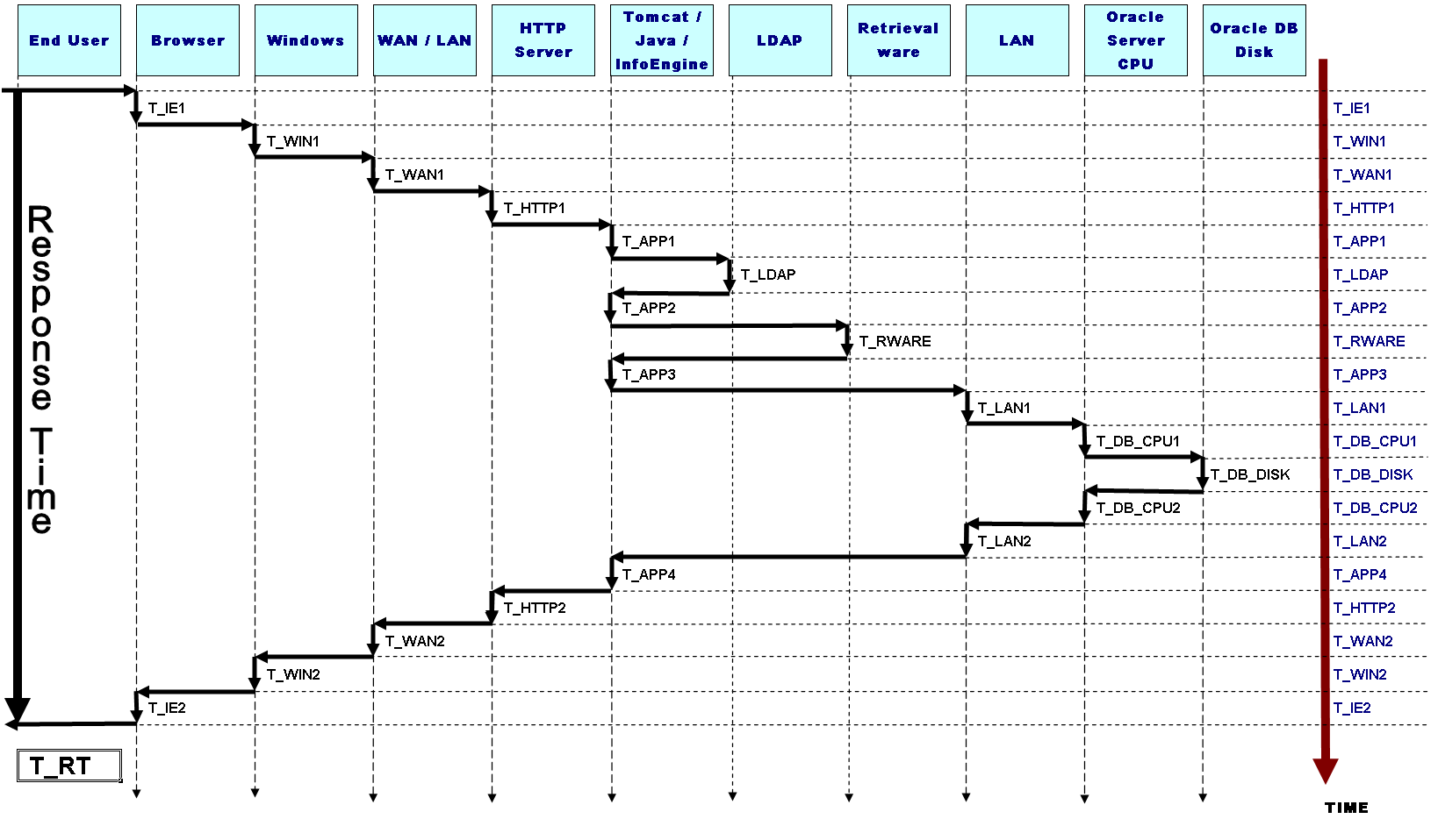
Total Response Time is an aggregate…
These are the major components we wish to size to ensure the best response time
End User
Browser CATIA
Windows
WAN LAN
HTTP Server
App Server
3D Index
Advanced Search
LAN
DB CPU
DB Disk
T_NETW
T_NETW
T_3DNDX
T_3DNDX
T_IDOL
T_IDOL
T_NETW
T_NETW

Slide 6




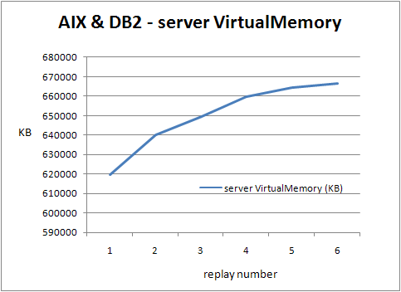
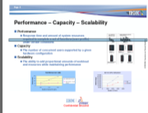
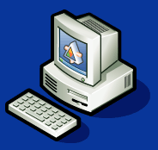




Performance Capacity Scalability Methodology
Performance
+
Scalability
Capacity (Sizing)
Predictive Model
Performance Model
100%
Ratio CPU/Time
User 1
True Concurrence happens when several transactions occur on same physical server
0%
100%
Ratio CPU/Time
User 2
0%
100%
Ratio CPU/Time
User 3
0%
100%
Ratio CPU/Time
User 4
Ratio CPU/Time
0%
100%
User 5
0%
100%
Ratio CPU/Time
Ratio CPU/Time
0%
100%
Ratio CPU/Time
User n
0%
100%
Ratio CPU/Time
0%
100%
Ratio CPU/Time
User p
0%
100%
DS/IBM
0%
………………….
User N
Delay between two Connections
100%
Ratio CPU/Time
Simulation Model
T_IDOL
0%
Each sample:
Captures the % of CPU required for :
ENOVIA Server
Data Base Server
Sums them to predict the # of actual concurrent users
Captures the # of concurrent transactions representing the nb of Client requests to ENOVIA Server
DS/IBM
Actual Customer Survey
Monitoring
Definition
Vendors (HW &SW)
Execution
System View: Resources Consumption
End user Usage View
Benchmarks

Slide 7
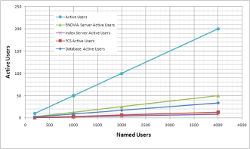



Active Users on a 3 Tier Architecture
Named Users |  | N=1,500 |  |  | Not Significant for a Sizing Estimation
Logged Users |  | Logged Users= 330 Logged Users=N/p |  |  | VPLM relies on a Stateless Server Low Login time out recommendation Ratio between Active users on client and Logged users close to 1 (.9<q < 1)
Active Users | Tier 1 Client | Active Users =300 Active Users =q*N/p |  |  | Active Users are users performing a scenario # of Active Users = # of Concurrent Scenarios
Concurrent Transactions | Tier 2 Applicative Servers | Index Server Concurrent Transactions= 12 Index Server Concurrent Transactions= Active Users /25 | ENOVIA Server Concurrent Transactions= 75 ENOVIA Server Concurrent Transactions= Active Users /4 | FCS Concurrent Transactions= 18 FCS Concurrent Transactions= Active Users /16 | Active Users are performing a transaction at Tier 2 level Servers
 | Tier 3 Database Server |  | Database Server Concurrent Transactions = Active Users /6=8 |  | Active Users are performing a transaction at Tier 3 level Server
CATIA V6
Index Server
File Collaborative Server
File repository
File repository
ENOVIA V6 Server
DB Server
Numbers and Ratios are only indicative and can differ depending on scenarios and ENOVIA Releases

Slide 8
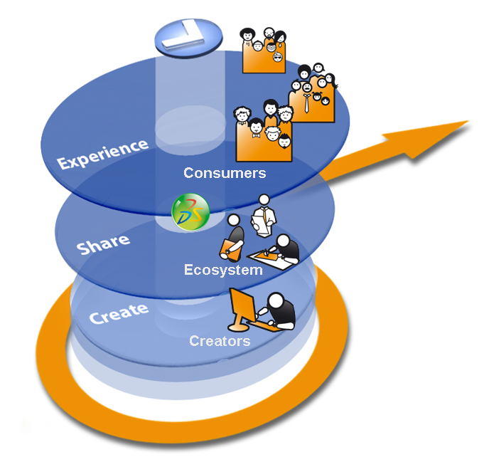
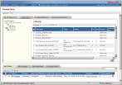
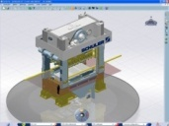









V6 Multi-Tier Architecture Principle
Web Clients Ex.: ENOVIA business process applications
Presentation
Light Visualization Clients Ex.: ENOVIA 3DLive
Workstation Clients Ex.: CATIA V6, DELMIA V6, SIMULIA V6, xCAD…
Clients
HTTP
Conferencing Server
Logic
Applications Server(s) (MCS)
Index Servers * Indexing Repositories
File Server(s) (FCS) Representation and Content Repository
Data
Database Server: Metadata Repository
(*) Optional.
Notes:
Data Tier
- Database Server Role: Storage of meta data i.e. “data about data”.
- Search Server
Role: Index meta data and files for key word searching and refinement.
- File Server called in ENOVIA “File Collaboration Server” or FCS / STORE
Role: Rapid storage and retrieval of representations (like CAD geometry for instance).
Physical view: Application Server + File server w/ FCS applications installed – the application server being limited to transfer files for the file server to the client seat.
Logic Tier
- Application Server called in ENOVIA “Main Collaboration Server” or (MCS) / RDBMS
Role: Handle the business logic and data access of the applications.
Physical view: Application Server w/ MCS applications installed
- Web Server(s) Role: Accept HTTP requests from web clients and serve them HTTP responses along with optional static contents (web pages, style sheets, java scripts, etc.).
Can be also used as a proxy/load balancing server.

Slide 9


Different Kinds of Sizing
Demo
Sandbox /
Training
Proof of Concept
Production Prototype
MCS + FCS +DB+NDX
MCS + FCS +DB Client +NDX
MCS +DB Client
FCS Server
Advanced Search Server
MCS +DB Client
FCS Server
DB Server
DB Server
3D Index Server
DB Server
Conferencing Server
Notes:
9
Different Technical infrastructure configurations to be defined according to customers requirements.
Examples of criteria:
number of users,
scalability requirements,
performance requirements
System management requirements
project phase,
geographical constraints,
E.g: The minimal installation could be used as a development platform as well as for functional tests and education.
Typically at deployment each Server is associated to a separate physical machine or partition.
Also shown in this architecture is the ability to use multiple application servers for scalability. Each application server is configured to run in a “RMI-in-process”, or RIP, mode. This consolidates the application server and the ENOVIA kernel into the same JVM for the utmost performance. The web server could be used as a proxy/load-balancing server and also increases performance by delivering static web content. A hardware load-balancer could also be deployed. The number of application servers depends on the number of concurrent users and the capacity of the application server in terms of the number of CPUs and the maximum amount of RAM. This could also be a single physical machine running multiple server processes.

Slide 10
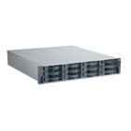

Two Examples
1 to 20 PLM users
20 to 100 PLM users
Master Collaboration Server +
Conferencing Server
- WAS 6.1
- Tivoli 6.2
2 cores – 8 Go
File Collaboration Server
WAS 6.1
Sametime 7.5.1
- Tivoli 6.2
2 cores – 4 Go
Master Collaboration Server
- WAS 6.1
- Tivoli 6.2
4 cores – 16 Go
File Collaboration Server
- WAS 6.1
- Tivoli 6.2
1 core – 4 Go
Storage FC-Attached
12 * 300 Go disks
Database Server
- DB2 V9.1
- Tivoli 6.2
4 cores – 16 Go
Database Server
- DB2 V9.1
- Tivoli 6.2
4 cores – 16 Go
Conferencing Server +
LDAP Server
- Sametime 7.5.1
- Tivoli Directory Server 6.0
- Tivoli 6.2
2 core – 4 Go
3D Index Server
- Tivoli ITCAM 6.2
2 core – 8 Go
IDOL Server (Advanced Search)
- Tivoli ITCAM 6.2
2 core – 4 Go
This is only a sample. A real sizing should be done for each customer in conjunction with IBM and DS
Notes:
Different Technical infrastructure configurations to be defined according to customers requirements.
Examples of criteria:
number of users,
scalability requirements,
performance requirements
System management requirements
project phase,
geographical constraints,
E.g: The minimal installation could be used as a development platform as well as for functional tests and education.
Typically at deployment each Server is associated to a separate physical machine or partition.
Also shown in this architecture is the ability to use multiple application servers for scalability. Each application server is configured to run in a “RMI-in-process”, or RIP, mode. This consolidates the application server and the ENOVIA kernel into the same JVM for the utmost performance. The web server could be used as a proxy/load-balancing server and also increases performance by delivering static web content. A hardware load-balancer could also be deployed. The number of application servers depends on the number of concurrent users and the capacity of the application server in terms of the number of CPUs and the maximum amount of RAM. This could also be a single physical machine running multiple server proces

Slide 11
Quick Sizing
CPU sizing
Memory Sizing (system included)
MCS: 4 GB / Core
FCS: 4 GB / Core
Database: 4 GB / Core (if possible)
Depends of the Database size
16 GB can be a good starting point with scaling up capability for VPM
Other Servers (typical starting configurations)
Autonomy IDOL Server: 2 CPU cores / 4 GB
3D Index Server(s): 2 CPU cores / 8 GB (build) or 4 GB (runtime) or 8 GB (build+runtime)
Conferencing Sametime/Domino: 2 CPU cores / 4 GB (no practical limit of users)
NOTE: Core here indicates the equivalent of a single core of an Intel Core2Duo or a single core of an IBM POWER5
To be tuned depending on precise customer requirements
 | # concurrent users per core
 | MCS | FCS | DB
Governance | 75 | 150 | 100
VPM | 30 | 100 | 60

Slide 12
Sizing Methodology
1
2
During Pilot Phase:
Define with Customer Critical scenarios and Workload
Validate with customers scope of customization
Execute with customers scenarios on Pilot environment
Quick Sizing:
Objectives: quick and rough estimation of sizing
When: Only If requested by Customer if no specific information available
3
During Pilot Phase or after Pilot Phase:
Validate Scenarios with ENOVIA PCS Expert
Define targeted infrastructure and Hardware
Decide if Measurements are needed on Pilot Environment
If requested involve PCS expert to perform Measurement
5
During deployment:
Ensure monitoring tools is in place
Review with Customer periodically workload and actual scenarios
4
During Pilot Phase or after Pilot Phase:
Request ENOVIA PCS Expert to use Predictive Model for Sizing
Disclose results to Customer advertising him about information is not contractual

Slide 13
Tools for Sizing and Architecture
Coming Soon!
Infrastructure Sizing Questionnaire
Infrastructure Assessment Templates
Infrastructure Services

Slide 14
Thank you

